Slide 1
Physiologic Responses of the Newborn to Birth
Presented by Connie S. Kelling, WHNP-BC, MSN, RN

Slide 2
Objectives:
Learn fetal circulation and the changes that occur at and post birth.
Learn the physiologic changes in all body systems as a neonate adapts to extra-uterine life.
Discuss common problems of the newborn in adaptation- i.e. thermoregulation, jaundice, etc.
Discuss management of common problems of physiologic adaptation of the newborn.

Slide 3
Respiratory System
Must function immediately after loss of placental function
Stimuli that promote respiration
Tactile stimuli
Temperature (cooler)
Chemical stimuli
Mechanical stimuli

Slide 4
https://www.khanacademy.org/science/health-and-medicine/circulatory-system/fetal-circulation/v/meet-the-placenta

Slide 5
Respiratory System
1st breath requires great deal of pressure
80-100mL of lung fluid must be cleared
1/3 is removed via chest compression
2/3 carried off thru pulmonary and lymphatic circulation
Surfactant-phospholipid that reduces surface tension in alveoli and prevents them from collapsing

Slide 6
Respiratory System
Norms:
Rate 30-60 breaths/min.
Normally irregular
May be transiently elevated after crying.
Count for 1 full minute and count before disturbing infant
Sneezing is normal. Clears airway of excess fluid

Slide 7
Respiratory System
Abnormal characteristics
Tachypnea--rate > 60 breaths/min
Grunting-Indicates baby cannot keep residual air in alveoli to keep them partially inflated
Flaring-Indicates baby can’t get enough air and is trying to widen air intake passageway
Retractions-Indicates baby is working hard against negative pressure to breathe

Slide 8
Circulatory System
Pulmonary circulation requires change from fetal circulation (high resistance to flow) to extrauterine circulation (low pulmonary vascular resistance).
Resistance influences direction of flow thru fetal shunts
Shunt=bypassing a certain point

Slide 9
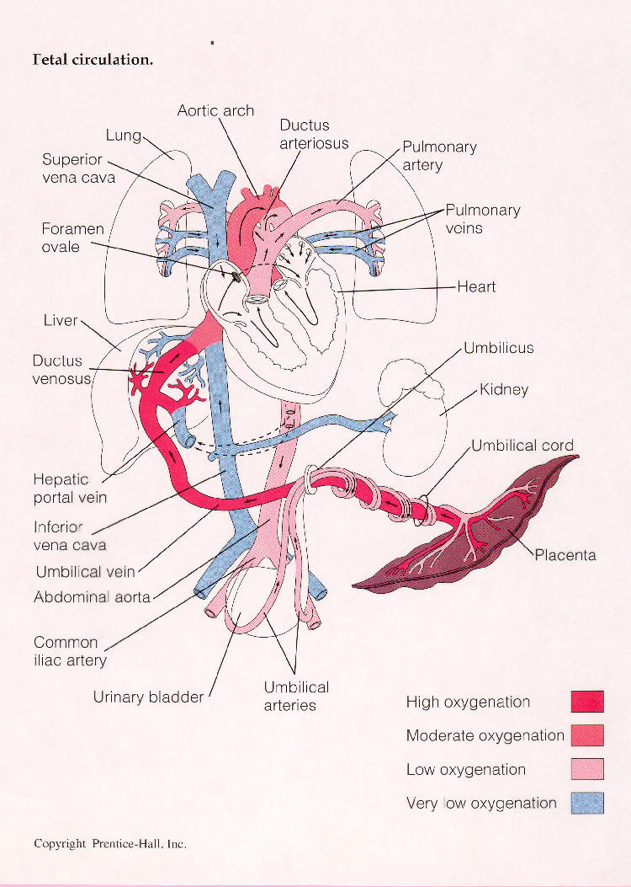
Notes:
Fetal circulation. **KNOW THIS! Study page 762-763 in your textbook.

Slide 10
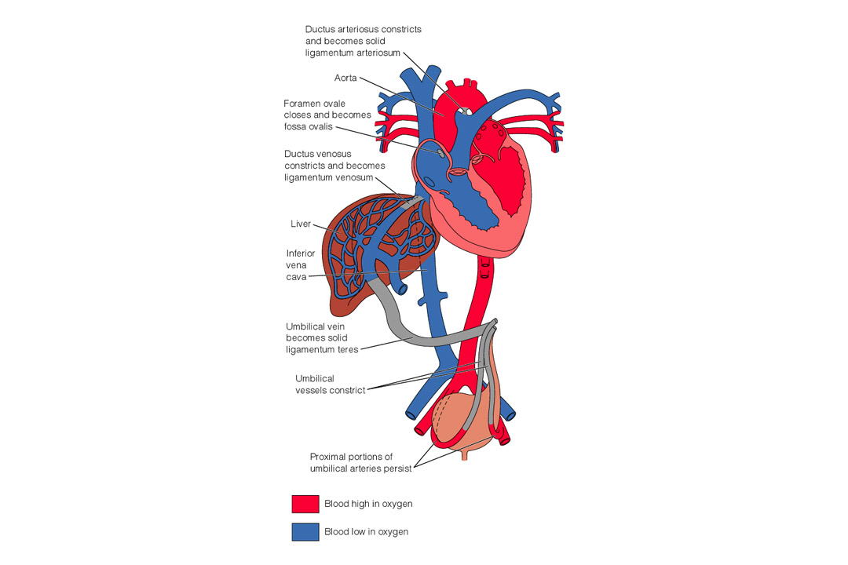

Slide 11
Fetal Shunts-Foramen Ovale
At birth, placenta blood flow is clamped. Pulmonary flow opens (becomes lower pressure). More blood to lungs means more blood returning to left atrium, which increases L.A. pressure. This closes valve functionally with 1st breath. Closes anatomically in several months.

Slide 12
Fetal Shunts-Foramen Ovale
At birth, placenta blood flow is clamped. Pulmonary flow opens (becomes lower pressure). More blood to lungs means more blood returning to left atrium, which increases L.A. pressure. This closes valve functionally with 1st breath. Closes anatomically in several months.

Slide 13
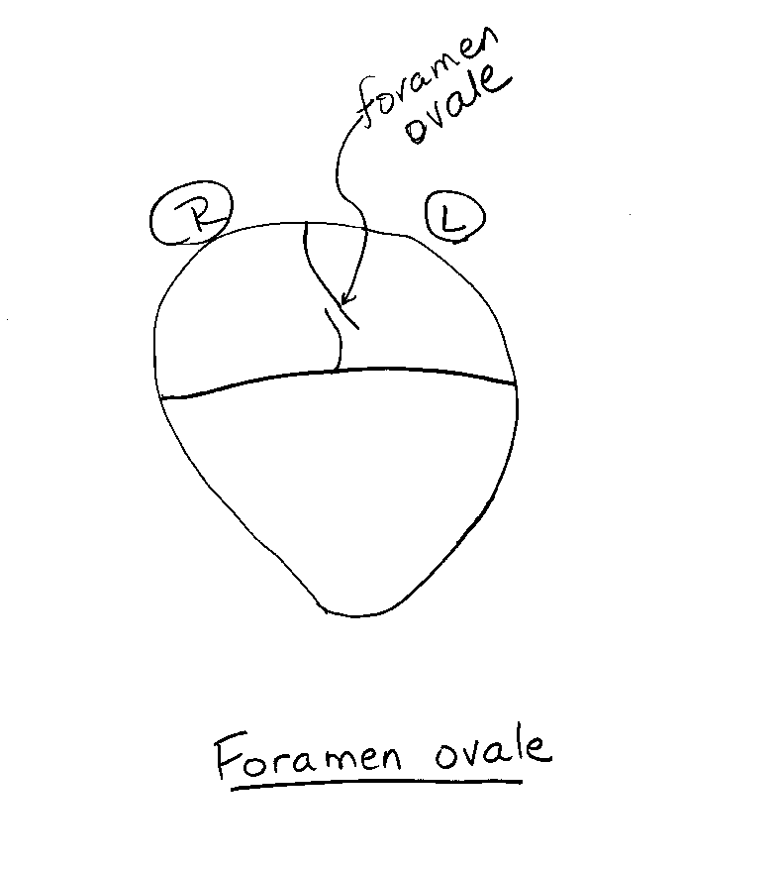

Slide 14
Fetal Shunts-Ductus Arteriosus
Located between pulmonary artery and aorta. Fetal flow allows more blood to bypass lungs. For fetus, this is a R --> L shunt.
At birth, pulmonary pressure is decreased; systemic flow is increased due to lack of placenta. Blood begins to flow from aorta back to pulmonary artery (L-->R shunt).

Slide 15
Fetal Shunts-Ductus Arteriosus
High O2 tension of blood that has just passed thru newborn lungs causes ductus to constrict. Becomes a ligament after several weeks (ligamentum arteriosum).

Slide 16
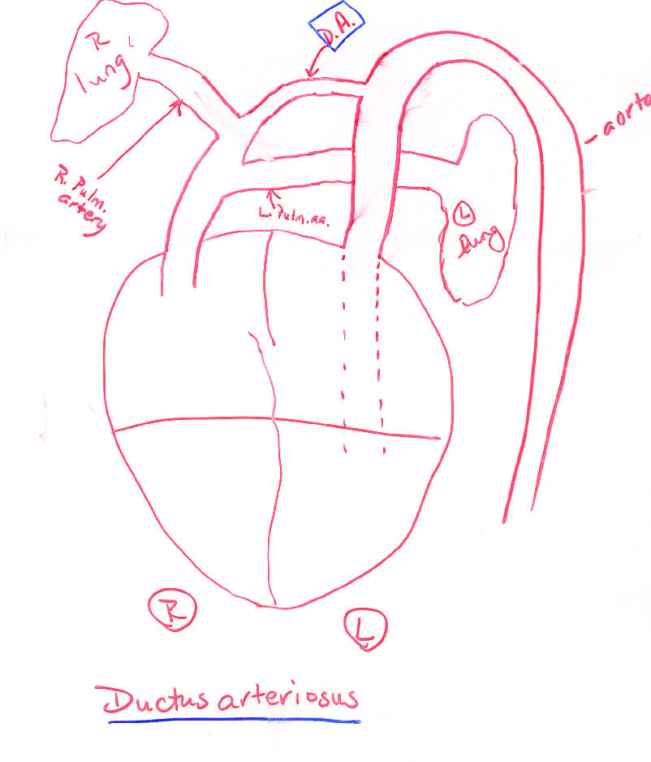

Slide 17
Fetal Shunts-DuctusVenosus
Located in liver. This is actually the umbilical vein as it passes through liver. Allows nutrient-rich blood from placenta to deposit and store glycogen in liver before entering fetal systemic circulation.
Closes when cord clamped due to decreased blood flow; becomes a ligament.

Slide 18
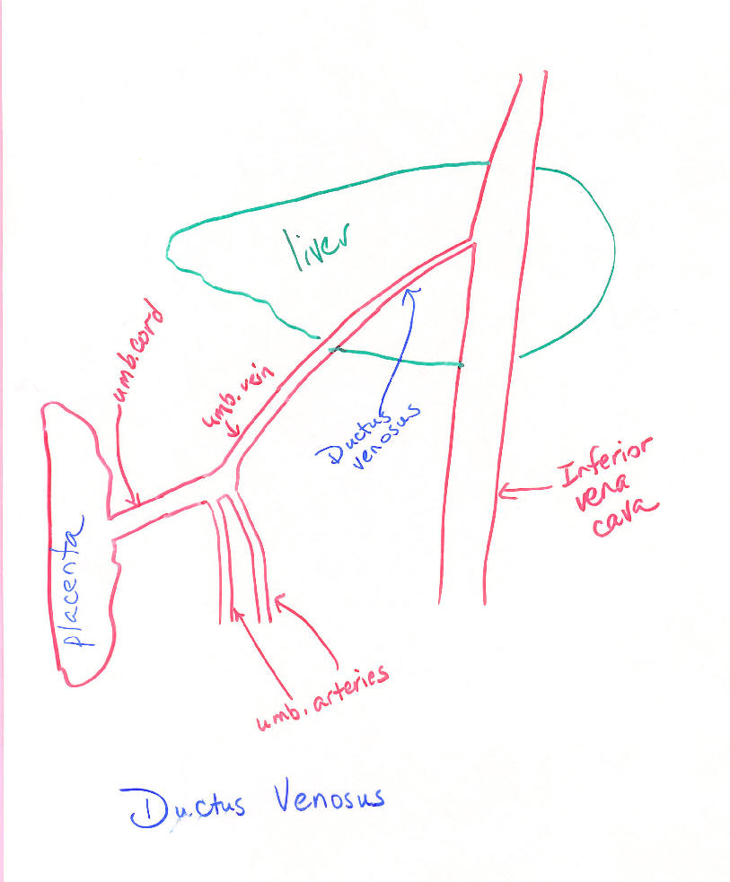

Slide 19
Cardiovascular Norms
Blood volume 80-110 mL/kg body weight (average 200mL total)
Heart rate 110-160; sinus arrhythmia normal
Acrocyanosis
BP 60-80 (systolic) /40-50 (diastolic)
Term norm 74/47 (by day 10 100/50)
Preterm norm 64/40

Slide 20
Normal Lab Values
Platelets 100-280K
Hgb 15-20
Hct 43-61%
WBC 10-30K
Ca 7.3-9.2
Glucose 45-97

Slide 21
Thermoregulatory Needs
Baby’s temp often decreased at birth
Methods of heat loss
Convection
Evaporation
Conduction
Radiation

Slide 22
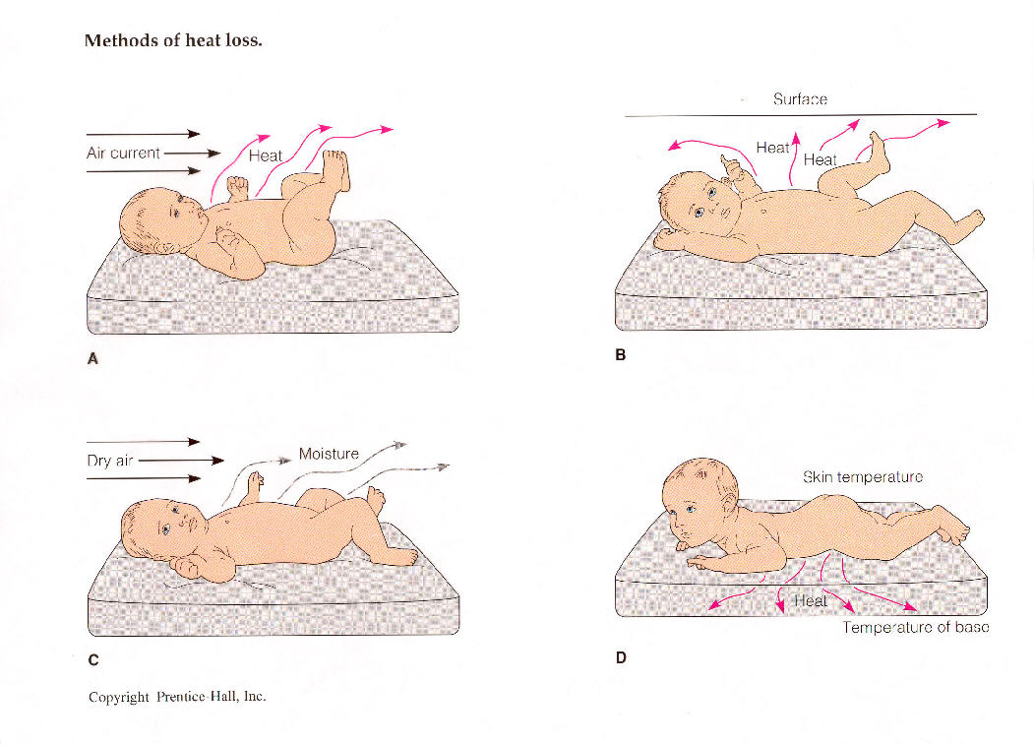
Notes:
A= convection, B= radiation, C= evaporation, D= conduction

Slide 23
Thermoregulation
Mechanisms to counterbalance heat loss:
Vasoconstriction (mottling). Take axillary temps!
Flexed posture
Non-shivering thermogenesis (brown fat metabolism)

Slide 24
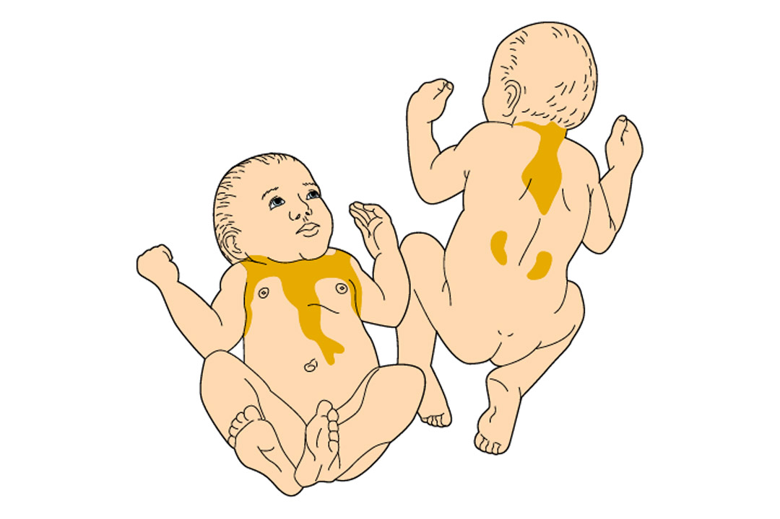

Slide 25
Temperature Norms
Axillary temps (5 min). 36.4-37º C (97.6-98.6º F)
A decrease of 3.5º F in environment can double the O2 consumption in a term neonate**

Slide 26
COLD
O2 need
Resp. rate
PO2
pH
vasoconstriction
glucose
effects maternal narcotics
PDA opens
fatty acids
bilirubin

Slide 27
GI System
GI tract inactive in fetal life, although baby swallows AF. Wastes excreted through placenta
GI function limited by anatomy and decreased acidity of GI contents
poor abdominal muscle tone, poor sphincter tone, slow gastric emptying time, underdeveloped cardiac sphincter, regurgitation
Lack of normal flora in bowel. Bacteria needed for synthesis of vitamin K

Slide 28
Normal Stooling Pattern
Meconium
Transitional
Breast fed stools
Formula fed stools
Loose stools normal; watery stools (water ring) are NOT!
1st stool in first 24 hours of life

Slide 29
Hepatic System
Immature in most neonates due to decreased GI activity; decreased blood supply
Decreased ability to conjugate bilirubin in liver
Bilirubin is a byproduct of the breakdown of red blood cells**

Slide 30
Bilirubin Metabolism Basics
Process of conjugation-The breakdown of fat-soluble indirect bilirubin to water-soluble direct bilirubin that can be excreted.**
Jaundice develops from the deposit of yellow pigment bilirubin into lipid tissues
Jaundice occurs in 50% of newborns at term, peaks at day 5

Slide 31
Bilirubin Metabolism Basics
Microbilirubin (or total bilirubin= total of direct + indirect
Fractionated bilirubin
Direct (water soluble, conjugated)
(small #)
Indirect (fat-soluble, unconjugated) (largDecreased enzyme function
Reabsorption from GI tract (enterohepatic circulation pathway, slow passage of stool)

Slide 32
Bilirubin Metabolism Basics
Contributing factors to jaundice
Increased hemolysis (high Hct, shorter fetal RBC life span, trauma with bruising, delayed cord clamping, sepsis)
Interference with albumin binding (competitors for albumin including FFA or drugs-ASA, excess vitamin K, sulfa)

Slide 33
Bilirubin Metabolism Basics
Contributing factors to jaundice (cont’d)
Decreased enzyme function
Reabsorption from GI tract (enterohepatic circulation pathway, slow passage of stool)

Slide 34
Bilirubin Metabolism Basics
Kernicterus
Results from high levels of bilirubin that cross blood-brain barrier staining basal ganglia causing permanent neurologic damage (muscle rigidity, hearing loss, irritability, arched posturing)

Slide 35
Treatment for Jaundice
Clinical Assessment
Blanch skin- forehead, chest
Use transcutaneous bilimeter (TCB)
Assess sclera- jaundiced there is late sign
Labs- heel stick
Force fluids (stimulates meconium passage)

Slide 36
Treatment for Jaundice
Phototherapy
Light absorbed by tissues converts unconjugated bili into photobilirubin, which can be bound to albumin and directly excreted into bile. Light also converts bili into a product that can be directly excreted into urine.

Slide 37
Treatment for Jaundice
Phototherapy can be done via high-intensity fluorescent or blue-lights, or via fiber-optic blanket.
Light therapy can increase insensible water loss

Slide 38
Treatment for Jaundice
AAP recommendations for phototherapy
Dependent on infant’s age in hours and bili level.

Slide 39
Hypoglycemia
Neonate at risk due to decreased ability to break down glycogen in liver.
Babies with inadequate stores include preemies, IDMs, stressed neonates.
Normal D-Stix > 45 mg/dL
Sx include jittery, poor feeder, lethargic, unstable temp

Slide 40
Renal System
GFR is 25% of adult level; rises to 50% by 1 week of age
Decreased ability to concentrate urine, easily dehydrated; SG < 1.025

Slide 41
Renal System
Bladder does function in utero; fetus voids into AF
Normally voids in 12-24 hr; 6-10 voids per day by 1 week of age
Urate crystals

Slide 42
Immune System
IgG--passive immunity from mother that crosses placenta
Immune factors present in colostrum
Infants more vulnerable to septicemia
Important to know mom’s history for risk factors
Sx--unstable temp, lethargy, poor feeder, “doesn’t act right”

Slide 43
Neurologic System
Myelination incomplete--drugs cross blood-brain barrier more easily
Development occurs in cephalocaudal direction
Primitive reflexes present at birth; should disappear as CNS matures

Slide 44
Reproductive System
Females -- pseudomenses
Males -- adhesions of the prepuce
Both sexes -- engorged breasts due to maternal estrogen exposure “witches milk”

